Slide 1

Youth, Entrepreneurship and Social Business Platform Prishtina 29th August 2012.
Lessens Learned, Serbia 2011
Rade Nikolić
CEO Kreativne Inovacije Ltd

Slide 2
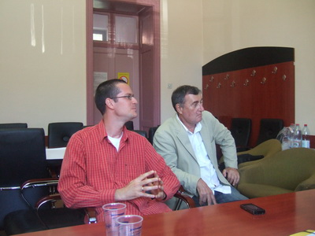

Bank support of Social Entrepreneurship
Case
An International Bank in Serbia created a program to support Social Entrepreneurship by giving credit loans of 500 Euro.

Slide 3
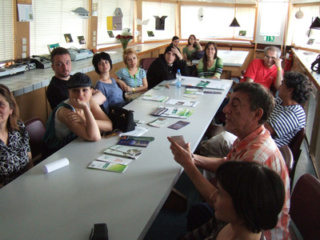
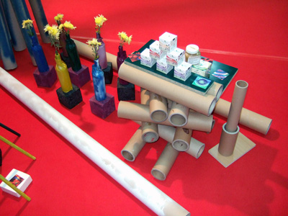
Government support of Social Entrepreneurship
Results
Some small business entities have been
established but collapsed when money stop
pouring in.

Slide 4
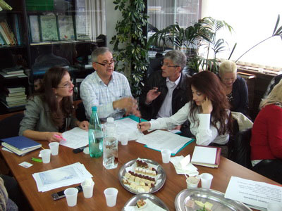
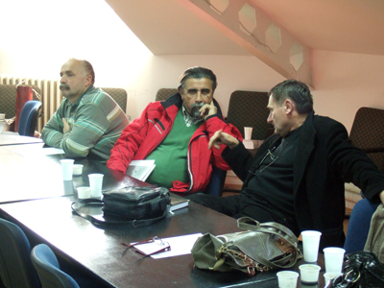
Bank support of Social Entrepreneurship
Why?
The Bank program collapsed because of bureaucratic obstruction in National Bank of Serbia.

Slide 5
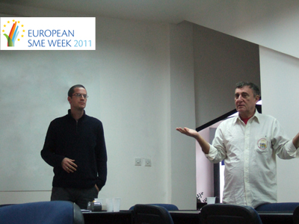
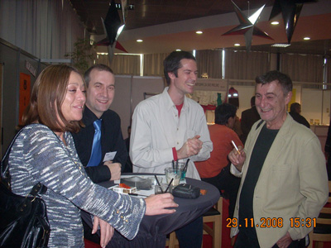
Some private Initiative
Kreativne Inovacije Ltd offered Consulting
service as a Grant
Results
No one was interested

Slide 6
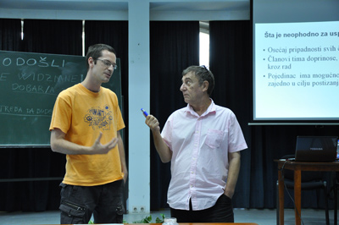
Conclusion
What must be done first?
Public support, not Government
Bank support, not Institution
Market focused, not Project
First local market, not foreign
At last, but not least,
People to people, not people to government.

Slide 7
At the End.......
Faleminderit, Thank you, Hvala, Danke
www.kreativneinovacije.com
Rade Nikolić

